Slide 1
Project Presentation on Ratings Price Prediction

Slide 2
Table Of Contents :
Problem Statement and understanding.
EDA Steps and Visualization
Data-Preprocessing
Set Of Assumptions Related To The Problem
Different Model Accuracies
Selection Of The Best Model
Conclusion

Slide 3
Problem Statement and understanding :
We have a client who has a website where people write different reviews for technical products. Now they are adding a new feature to their website i.e. The reviewer will have to add stars(rating) as well with the review. The rating is out 5 stars and it only has 5 options available 1 star, 2 stars, 3 stars, 4 stars, 5 stars. Now they want to predict ratings for the reviews which were written in the past and they don’t have a rating. So, we have to build an application which can predict the rating by seeing the review.

Slide 4
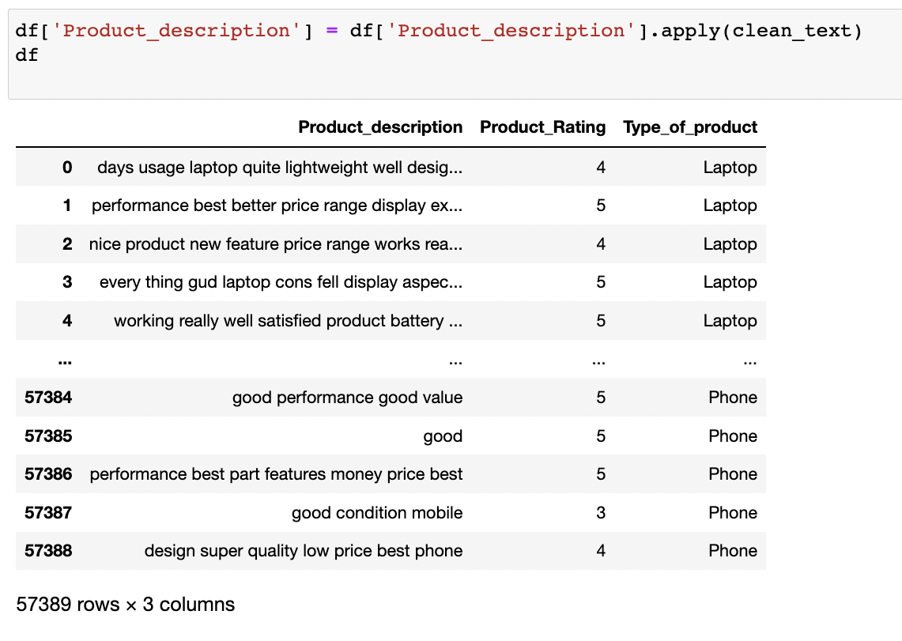
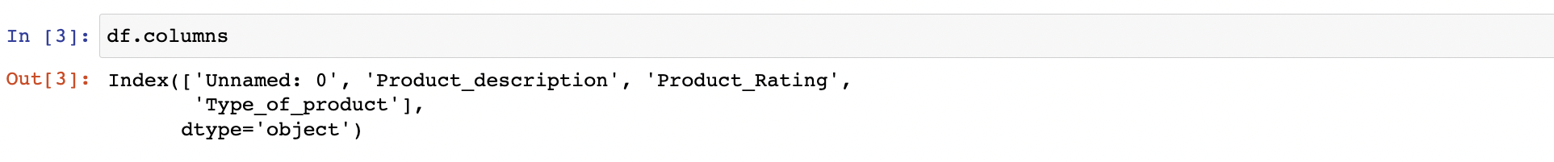
EDA Steps and Visualization :
we have 4 features, out of 4 one is not needed for model creation because it is speaking about indexes(Dropping feature is required)
Product description feature talks all about the comment given by the user
Product feature talks all about the rating given by user for the product
Type of product feature name itself explains that it speaks about category of product

Slide 5
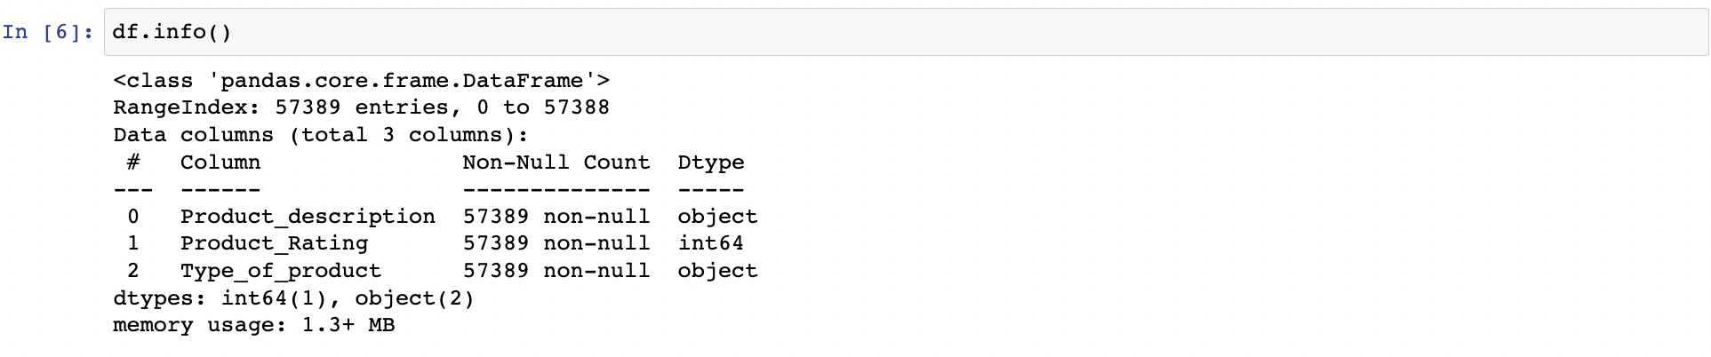
EDA Steps and Visualization :
There is no null values in the dataset
Dataset conatins 2 object type and one int type variable sets in dataframe

Slide 6
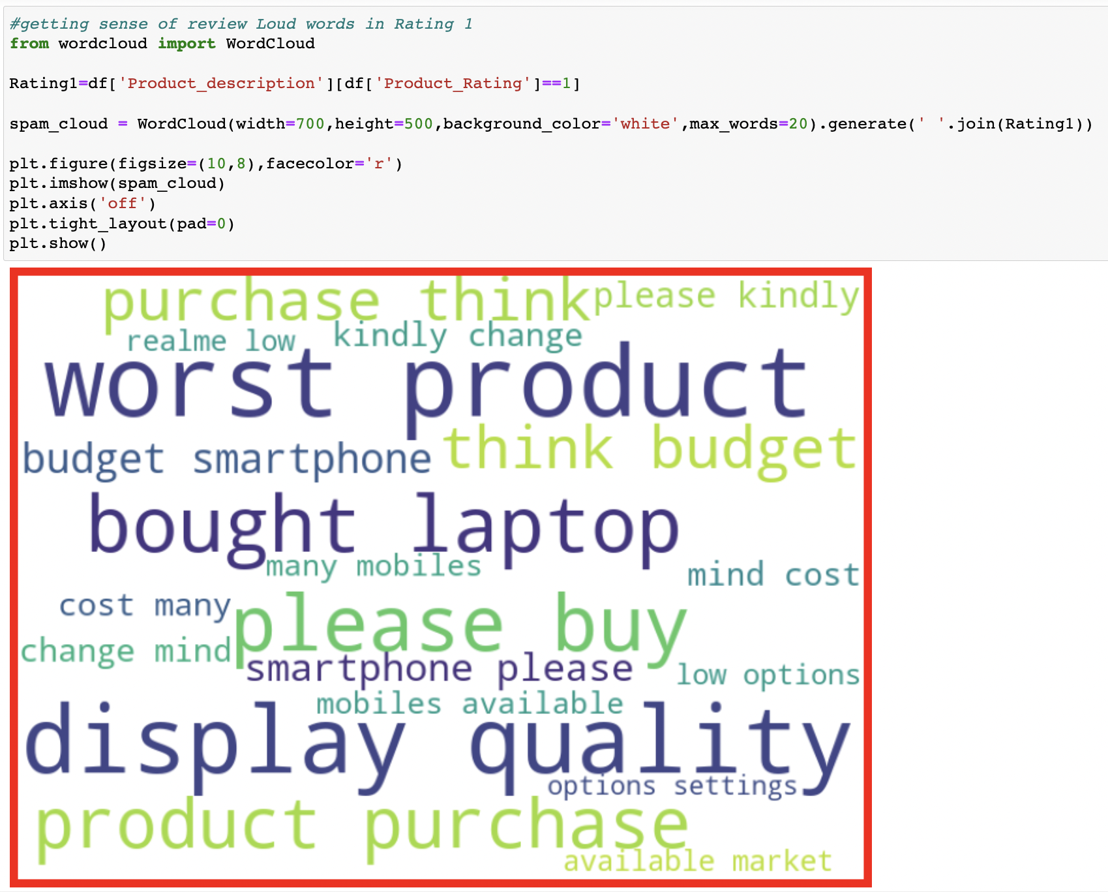
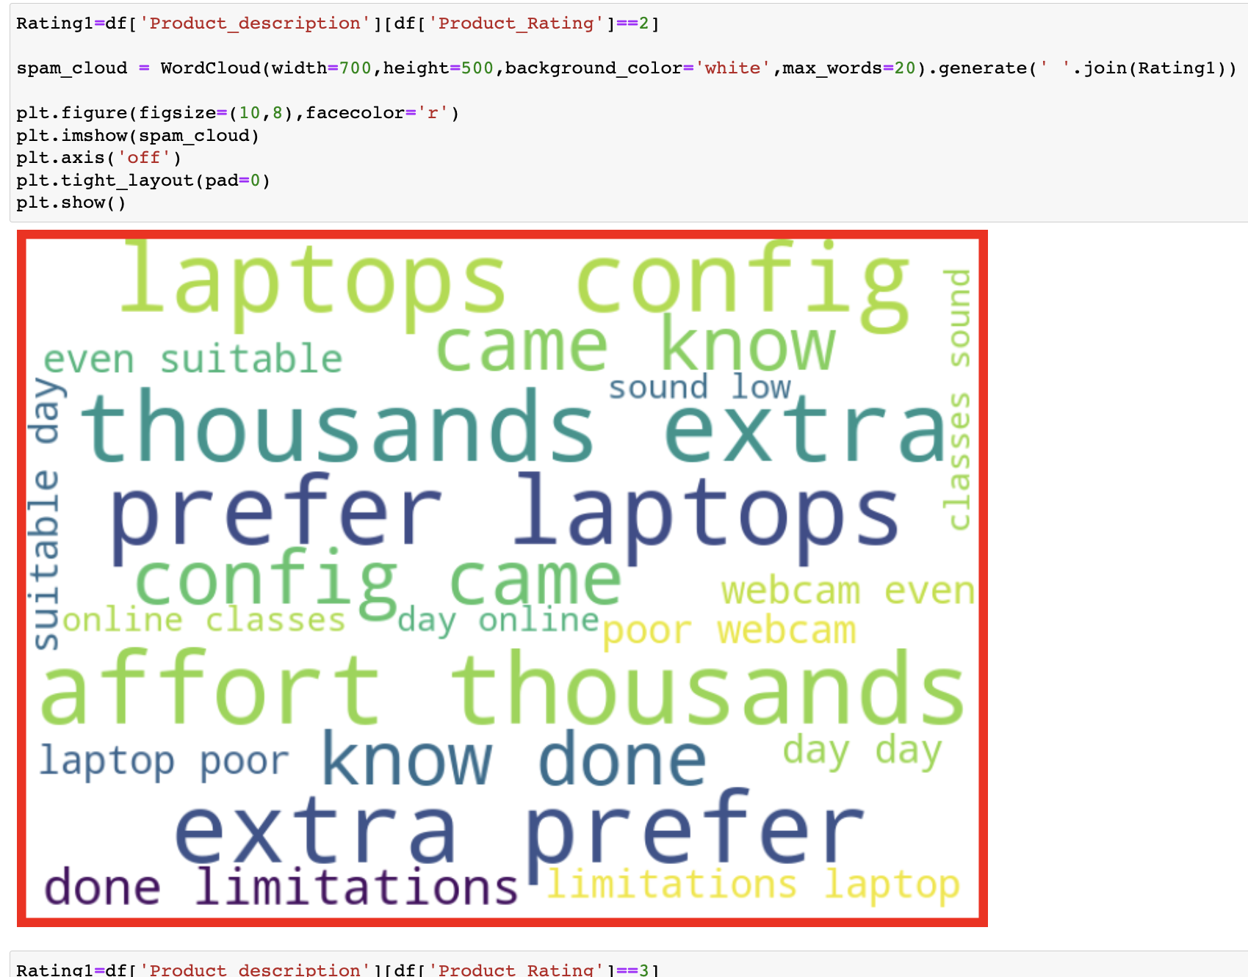
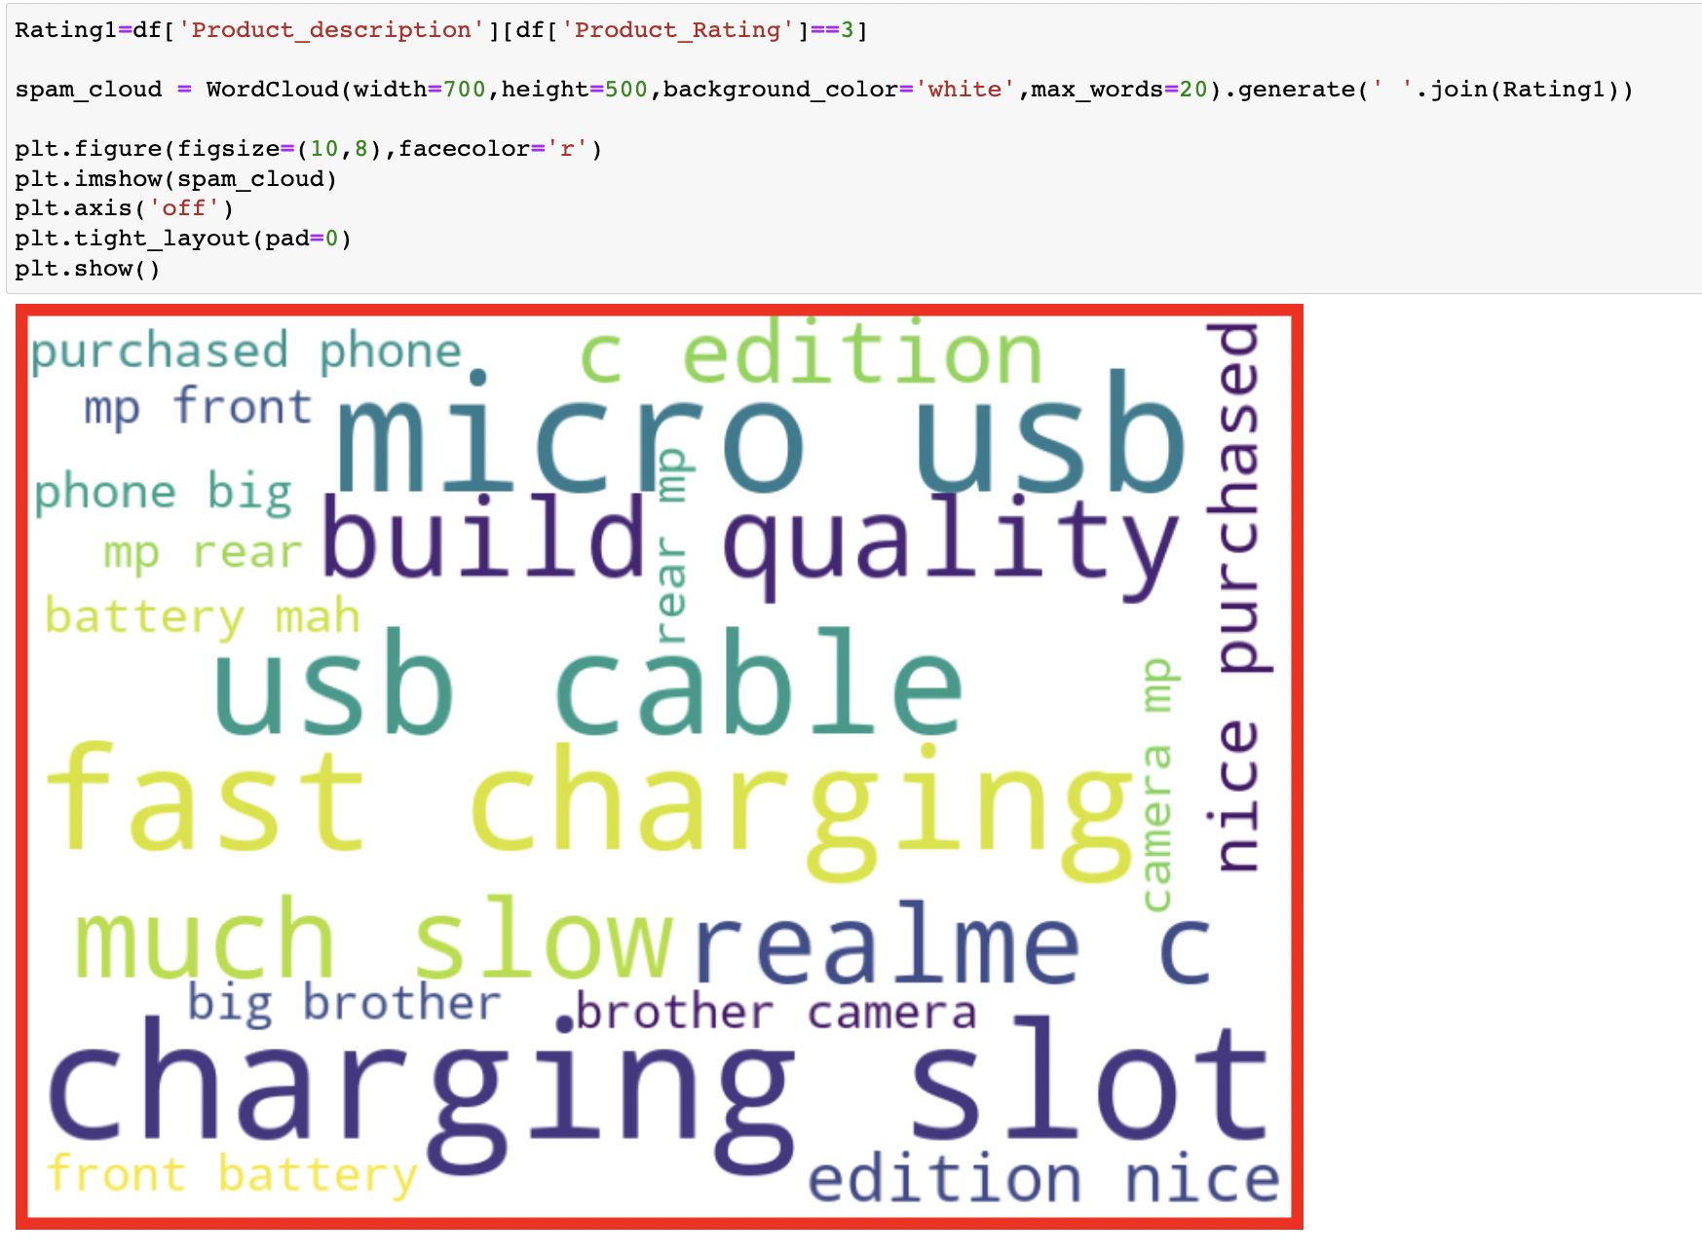
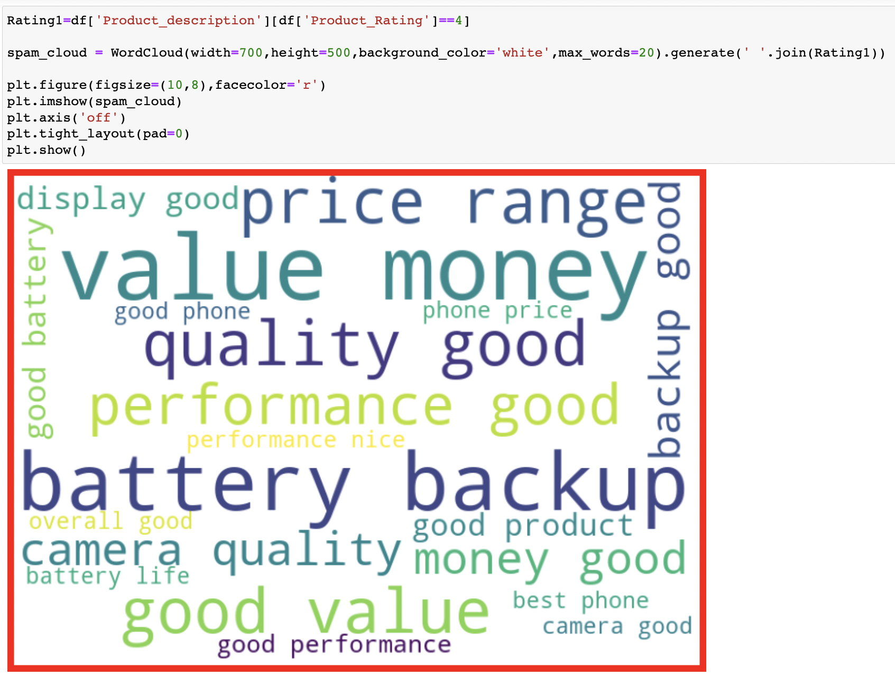
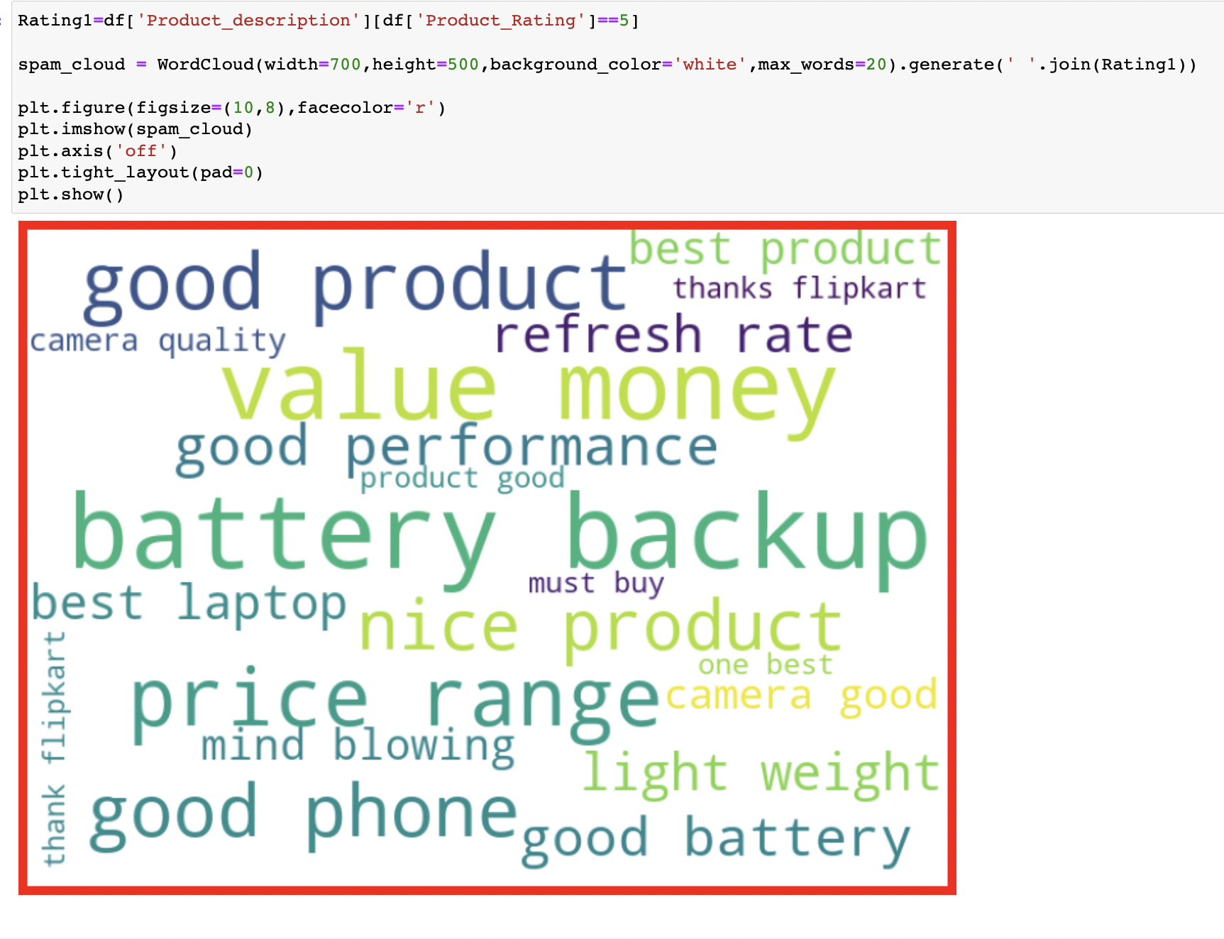
Review Loud Words In Ratings :

Slide 7
Data-Preprocessing
I have first looked for the null values present in the dataset and noticed that there were no null values present in the dataset. Then i performed text processing. Data usually comes from a variety of sources and often in different formats. For this reason transforming your raw data is essential. However, this is not a simple process, as text data often contains redundant and repetitive words. This means that processing the text data is the first step in our solution. The fundamental steps involved in text preprocessing are, Cleaning the raw data Tokenizing the cleaned data.

Slide 8
Steps Involved in Data-Preprocessing
Removing Stop Words
Stemming
Removing Punctuations and Special Characters
Applying tfidf Vectorizer
Applied SMOTE Technique To Handle Imbalance Of Data

Slide 9
Set Of Assumptions Related To The Problem
By looking into the target variable label I assumed that it was a Multiclass classification type of problem.
I observed that dataset was imbalance, so I will have to balance the dataset for better outcome.

Slide 10
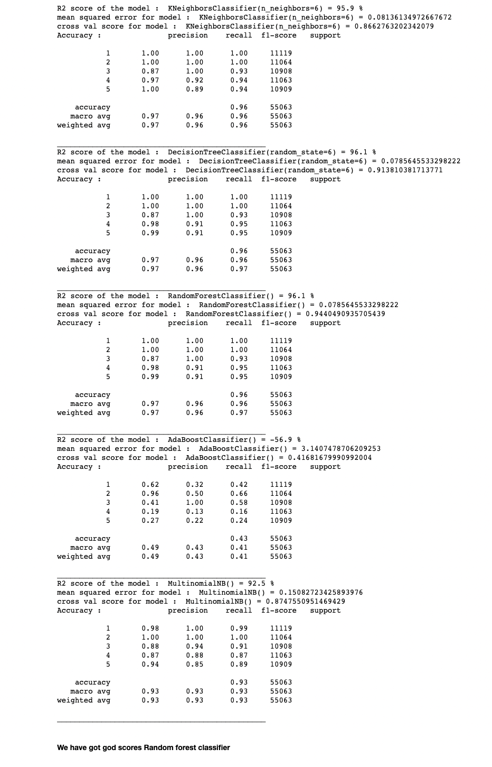
Different Model Accuracies

Slide 11
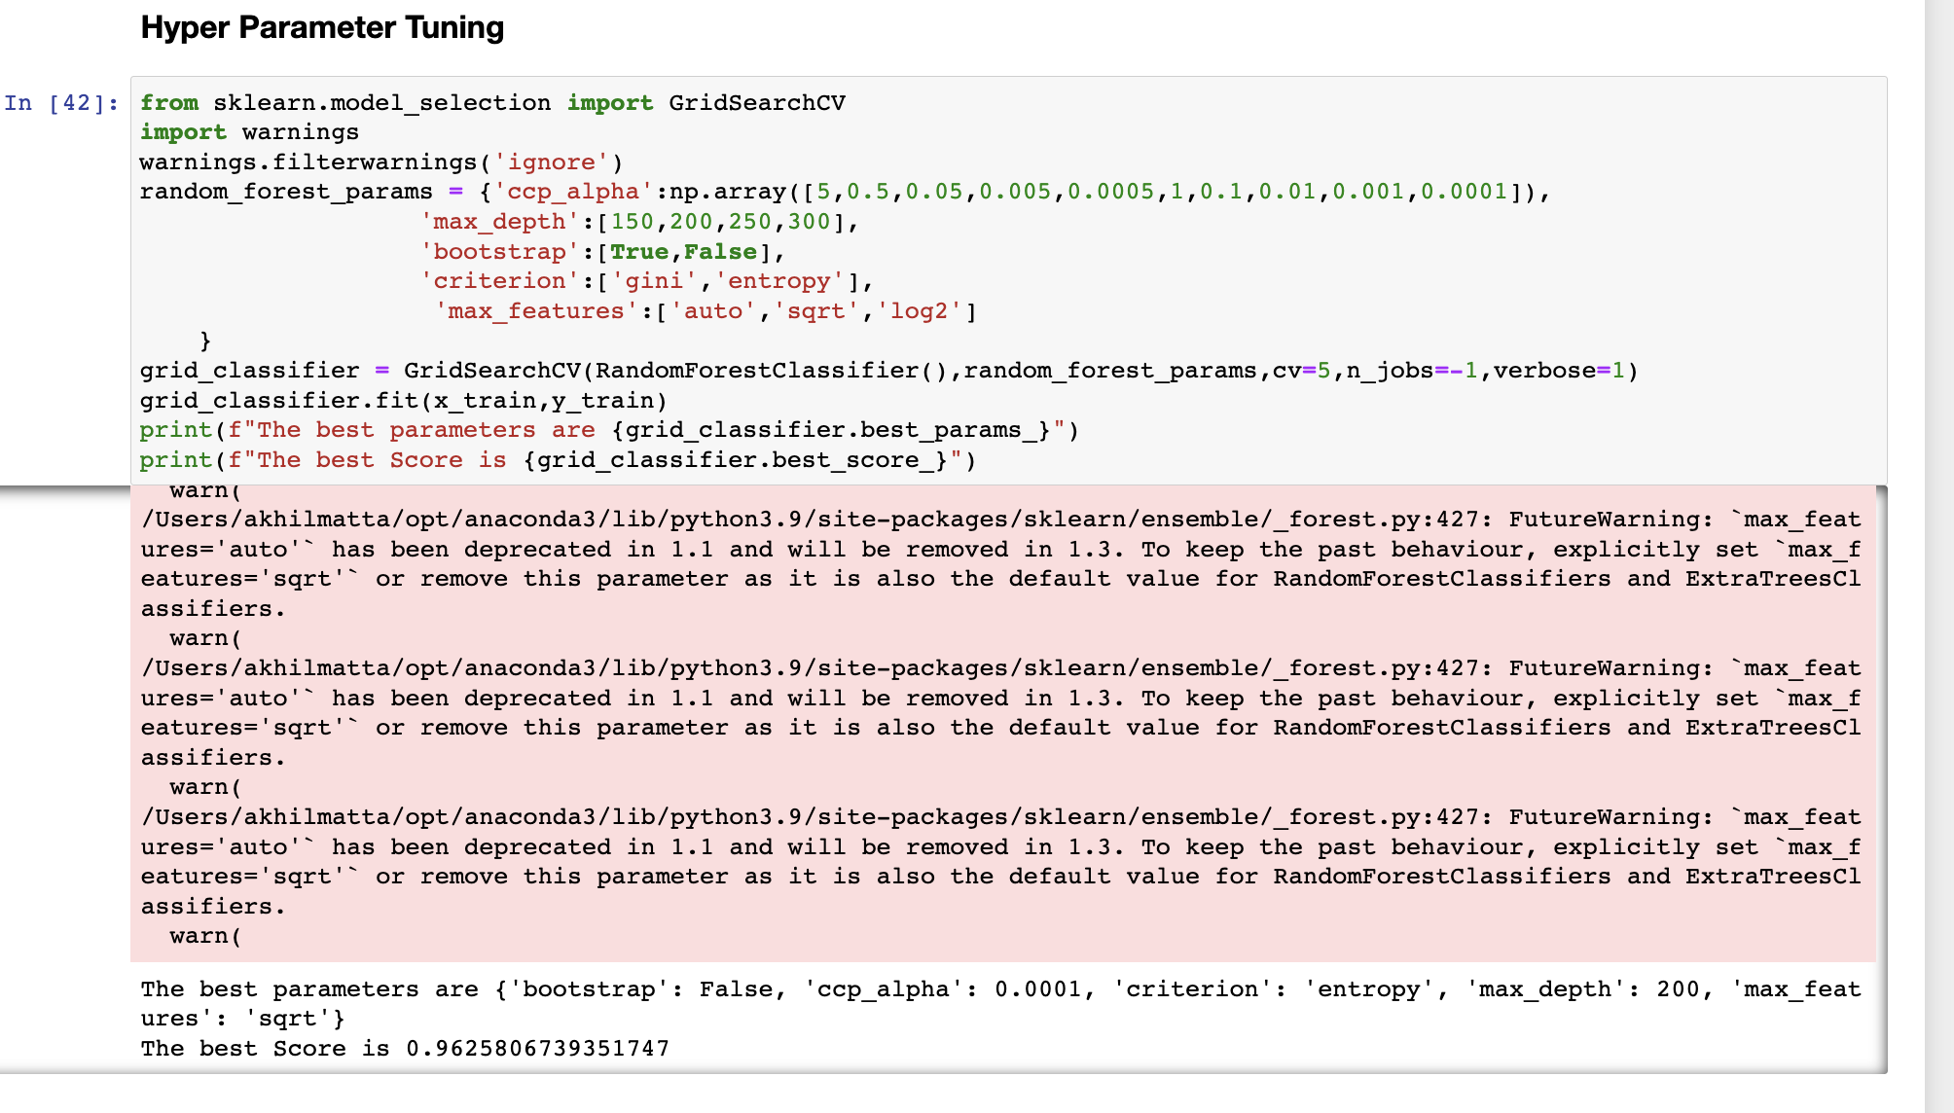
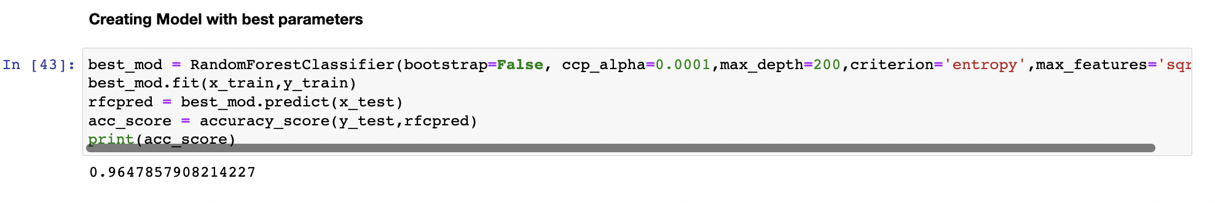
Selection Of The Best Model
We have got good scores Random forest classifier
Accuracy is 96.4%

Slide 12
Conclusion
In this project we have tried to detect the Ratings in commercial websites on a scale of 1 to 5 on the basis of the reviews given by the users. We made use of natural language processing and machine learning algorithms in order to do so. We interpreted that Random forest classifier model is giving us best results.

